Slide 1



Layoff
Assistance

Slide 2

PURPOSE
Provide information on unemployment benefits and programs.
Discuss employment and training assistance programs.
Connect to other federal, state, and local resources.
Notes:
Rapid Response is a no cost program designed to get you back to work as quickly as possible following a layoff or plant closure. The purpose of this Rapid Response Orientation is to:
Provide information on the unemployment compensation benefits and programs,
Discuss employment and training programs available through the comprehensive one-stop delivery system, and
Connect you to other federal, state, and local resources.
These services and resources are customized to your needs, with the goal of minimizing the disruptions on your life associated with job loss. These services are carried out by state and local workforce development agencies in partnership with the America’s Job Center of CaliforniaSM network.

Slide 3

About Unemployment
Paid for by your employer.
Provides temporary partial-income replacement when you are unemployed or have had your hours reduced due to no fault of your own and all weekly eligibility requirements are met:
  Physically able to work
  Available to work
  Actively seeking work

Slide 4
About Unemployment (cont.)
Pays $40 to $450 per week based on your highest quarterly earnings during the base period.
Provides up to 26 weeks of benefit payments.
An unemployment claim is valid for one year.
There is a seven-day mandatory, unpaid waiting period.
Begins the Sunday of the week you file.

Slide 5


Unemployment Benefit Calculator
The unemployment benefit calculator is a helpful tool that will give you an estimate of your weekly benefit amount, which can range from $40 to $450 per week.
  edd.ca.gov/en/Unemployment/UI-Calculator

Slide 6

Ways to Apply for Unemployment
Online (recommended)
edd.ca.gov/en/unemployment/ui_online
Fax or Mail
  Complete, sign, and fax or mail the paper UI Application
  (DE 1101i) as directed on
  the form.
  For more secure processing, fax your application to the EDD.
Phone
  English and
  Spanish: 1-800-300-5616
  Mandarin: 1-866-303-0706
  Armenian: 1-855-528-1518
  Tagalog: 1-866-395-1513
  Cantonese: 1-800-547-3506
  Vietnamese: 1-800-547-2058
  Korean: 1-844-660-0877
  TTY: 1-800-815-9387
  California Relay Service (711): Provide the UI number
  (1-800-300-5616)
  to the operator

Slide 7

Information You Will Need
Personal
Last employer
Employment history
Identity documents

Slide 8

After You Submit Your Application
Allow 7 to 10 days for processing.
We will mail you important information about your claim and the program within 5 to 10 days.
Read through everything we mail you and respond to us on time to avoid delays.
We send you the first Continued Claim Form (DE 4581) by mail for you to certify for benefits.
Be sure to certify for benefits every two weeks.

Slide 9

Certify for Benefits
To get paid, you must answer eligibility questions every two weeks. This process is known as certifying for benefits.
There are three ways to certify:
  UI Online (recommended)
  EDD Tele-Cert 1-866-333-4606
  By Mail

Slide 10

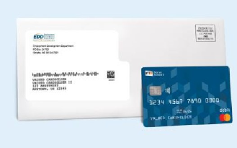
Debit Card
  When your first payment is authorized, Money Network will mail you a debit card.
  We issue unemployment, disability, and Paid Family Leave benefits using a visa debit card.
  The debit card is valid for three years. You will not receive a new card if you already received one from a previous claim.
  You can set up alerts when a deposit is available or there is a low balance.
  To request a replacement card, report a lost or stolen card, or for questions call Money Network EDD Debit Card Customer Service at 1-800-684-7051, or visit https://www.moneynetwork.com/edd.

Slide 11

California Training Benefits (CTB)
You can receive unemployment benefits while you continue your education, upgrade your skills, or learn a new trade by going to an approved training or program.
If eligible for CTB:
    You will not need to be available for work, accept suitable work, or actively seek work.
    You may qualify for a training extension for up to 26 more weeks of benefits.
    If you're interested in the program, you must notify the us prior to receiving your 16th week of benefits.
Learn more at edd.ca.gov/CTB.
Note:
We do not cover any educational or training-related expenses such as tuition, books, supplies, transportation or fees. There may be state, federal, or employer programs that provide funding or financial assistance.

Slide 12

America’s Job Center of CaliforniaSM
The America's Job Center of California (AJCC) offers a variety of services that bring employers with job openings and qualified job seekers together at no cost.
There are several types of services available at an AJCC:
  Workforce Innovation and Opportunity Act (WIOA).
  Trade Adjustment Assistance (TAA) program information.
Notes:
The America's Job Center of CaliforniaSM (AJCC) offers a comprehensive range of no-cost employment and training services for employers and job seekers.
There are several types of services available at an AJCC:
Workforce Innovation and Opportunity Act (WIOA) funding provides career, training, and supportive services.
the Trade Adjustment Assistance (TAA) program is a federal program that provides training, case management and employment services, job search allowances, relocation allowances, and income support to individuals who have been laid off, or threatened with layoff, due to foreign trade.

Slide 13
America’s Job Center of California
  Career planning.
  Skills assessment.
  Workshops.
  Labor market information.
  Job fairs and other job matching services.
  Marketing workers to area employers.
  Occupational training.
Notes:
The AJCC also provides:
Career planning
Skills assessment
Workshops such as résumé writing and interviewing techniques
Labor market information, which is provided by the Employment Development Department on its website and includes occupational profiles (and projections of employment) for occupations and industries throughout California.
Job fairs and other job matching services
Marketing workers to area employers
Occupational training

Slide 14
America’s Job Center of California cont.
  Special services for veterans and youth.
  Job clubs.
  Employer recruitments.
  Training and other resources.
  CalJOBSSM: caljobs.ca.gov
    Access to thousands of job openings statewide.
    Access 24 hours a day, 7 days a week.
    No fee to use.
Notes:
The AJCC system also offers:
Special Services (if eligibility requirements are met) to Veterans (such as one-on-one desk coaching/career counseling/GI Bill), and Youth through the Youth Employment Opportunity Program for at-risk youth aged 15-25 years old.
Experience Unlimited Job Clubs, which are a Job Search association for professional, technical and managerial
Employer Recruitments- AJCCs host on-site and virtual employer recruitments
AJCCs consider the availability of other resources and grants to pay for training costs such as Temporary Assistance for Needy Families (TANF), State-funded training funds, and Federal Pell Grants, so that WIOA funds supplement other sources of training grants. You can contact your local AJCC for more information on local programs and other community resources.
And, last, but not least, CalJOBS: A no-cost Internet job search system accessible from any computer 24 hours a day, 7 days a week. CalJOBS allows you to tailor and save multiple résumés to submit to employers. Employers can also view your resume based on key words. In addition, CalJOBS searches the internet and sends emails of job listings that match job search objectives. You can access CalJOBSSM at caljobs.ca.gov.
Most UI customers are required to register for CalJOBS and create an online resume that can be viewed by employers. You must meet this requirement within 21 days of receiving your Notice of Requirement to Register for Work (DE 8405) form. Failure to meet this requirement can result in a delay or loss of UI benefits.

Slide 15

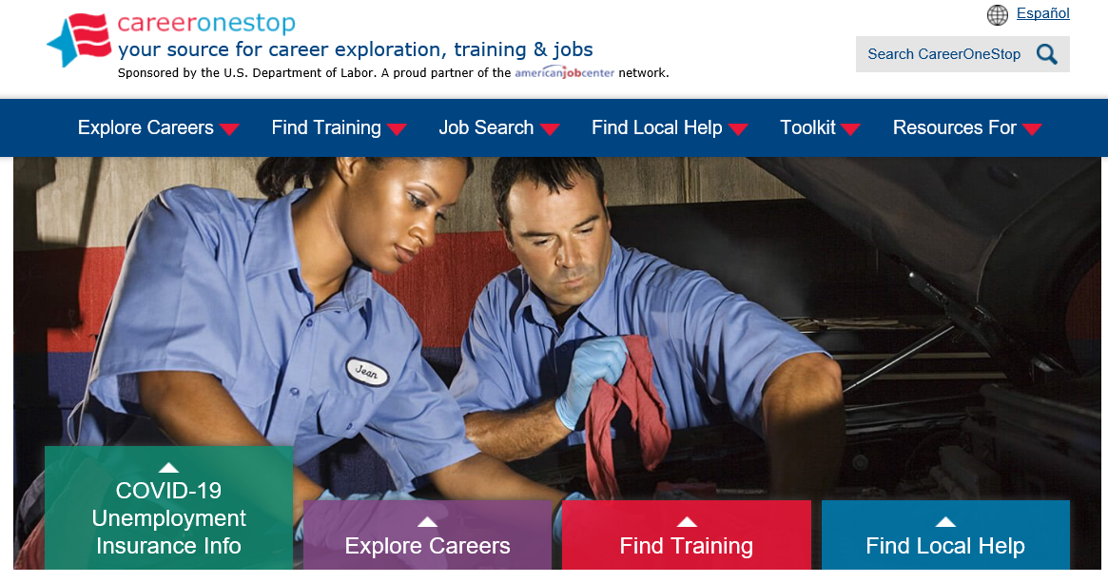
careeronestop.org
Notes:
To connect with your local America’s Job Center of CaliforniaSM, you can visit careeronestop.org. In addition to finding local help, this website is your source for career exploration, training and jobs.
[LOCAL AREAS CAN ADD IN SLIDES FOR THEIR SPECIFIC OFFICES/SERVICES/PROGRAMS/GRANTS AFTER THIS SLIDE]

Slide 16

Labor Market Information
Division
The Labor Market Information Division (LMID) regularly collects,
analyzes, and publishes information about California’s labor market.
  Also provides economic development and planning information.
Types of information available:
  Occupational profiles and occupation comparisons.
  Projections of employment for occupations and industries by
  county.
  Growth and decline industries in all counties in California.
Find additional information on the EDD website:
labormarketinfo.edd.ca.gov
Notes:
[OPTIONAL = IF LIMITED ON TIME, THIS SLIDE CAN BE SKIPPED]
[READ SLIDE]

Slide 17

State Disability Insurance Program
Disability Insurance (DI) is a partial wage replacement for eligible California workers.
Paid Family Leave.
Cannot collect DI at the same time as UI.
Find additional information on the EDD website: edd.ca.gov/disability
Notes:
[OPTIONAL = IF LIMITED ON TIME, THIS SLIDE CAN BE SKIPPED]
Disability Insurance (DI) is a component of the State Disability Insurance program. It provides partial wage replacement benefits to eligible California workers who are unable to work due to a non-work-related illness, injury, or pregnancy and is funded through employee payroll deduction. Although work-related disabilities are covered by workers’ compensation laws, DI benefits may also be paid for work-related illness or injuries under certain circumstances.
Paid Family Leave (PFL) provides benefits to individuals who need to take time off work to care for a seriously ill child, parent, parent-in-law, grandparent, grandchild, sibling, spouse, or registered domestic partner. Benefits are also available to parents who need time to bond with a new child entering their life either by birth, adoption, or foster care placement.
It is important to note that you cannot collect Disability Insurance at the same time as Unemployment Insurance.
For additional information on Disability Insurance in California, you can access the EDD website: edd.ca.gov/disability

Slide 18

Covered California
No cost service that connects Californians with brand-name health insurance.
Financial help when you buy health insurance from well-known companies.
May qualify for a discount on a health plan or get insurance through Medi-Cal.
Notes:
[OPTIONAL = IF LIMITED ON TIME, THIS SLIDE CAN BE SKIPPED]
Covered California is a no cost service that connects Californians with brand-name health insurance under the Patient Protection and Affordable Care Act.
It’s the only place where you can get financial help when you buy health insurance from well-known companies.
That means when you apply, you may qualify for a discount on a health plan through Covered California, or get health insurance through the state’s Medi-Cal program. Either way, you’ll have great health coverage.

Slide 19

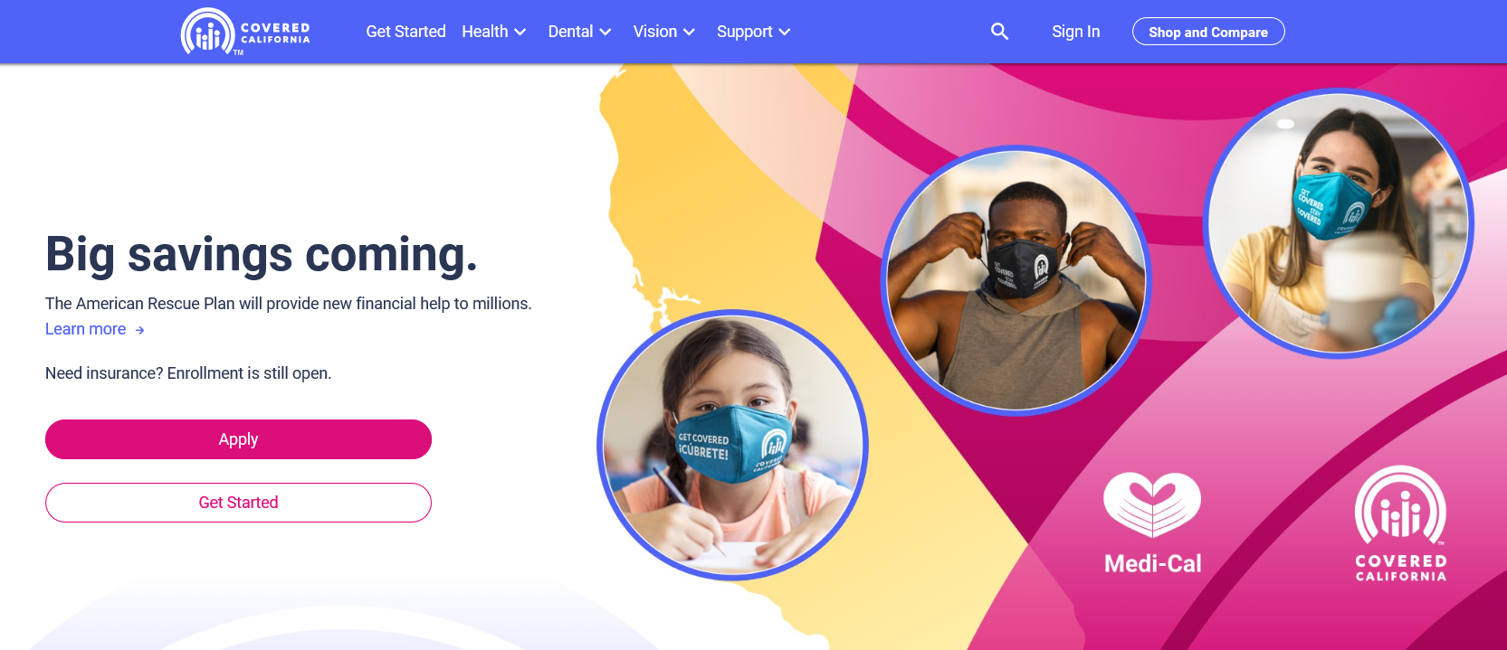
coveredca.com
Notes:
[OPTIONAL = IF LIMITED ON TIME, THIS SLIDE CAN BE SKIPPED]
Additional information can be found on the website: coveredca.com

Slide 20

US Department of Labor
Consolidated Omnibus Budget Reconciliation Act (COBRA).
Health Insurance Portability and Accountability Act (HIPPA).
Employee Retirement Income Security Act (ERISA).
Affordable Care Act (ACA).
Find additional information on the DOL website: dol.gov.
US Department of Labor’s Employment Benefits Security Administration: 1-866-444-3272.
Notes:
[OPTIONAL = IF LIMITED ON TIME, THIS SLIDE CAN BE SKIPPED]
There are several U.S. Department of Labor Resources available to you:
COBRA -The Consolidated Omnibus Budget Reconciliation Act is a federal law that extends your current group health insurance when you experience a qualifying event such as termination of employment or reduction of hours to part-time status.
HIPAA -Health Insurance Portability and Accountability Act provides the ability to transfer and continue health insurance coverage for millions of American workers and their families when they change or lose their jobs
The Employee Retirement Income Security Act is federal law that sets minimum standards for pension plans in private industry
For additional information, access the website at dol.gov
You can also contact the U.S. Department of Labor’s Employment Benefits Security Administration at 1-866-444-3272.

Slide 21

The EDD is an equal opportunity employer/program. Auxiliary aids and services are available upon request to individuals with disabilities.

Slide 22




A Guide to Understanding your Retirement Plan Options
Withdrawing the Cash Value of Your Retirement Plan
Advantage:
Fastest way to receive your money
Disadvantage:
Your money will not be there to help you when you retire
You will typically pay the highest percentage of taxes
Example:
$10,000 Gross Withdrawal
- $2,000 Federal Income Tax (28%)
- $800 CA State Income Tax (8%)
- $1,000 Early Distribution Penalty (10%)*
$5,400 Net Withdrawal *
Notes:
EDD

Slide 23

A Guide to Understanding your Retirement Plan Options 2
A Guide to Understanding your Retirement Plan Options
Move Money to your New Employers Plan
Advantage:
You pay no penalty or taxes
Disadvantage:
Not all employers provide this option
You may not be eligible to join the retirement plan until after a probation period or a required service time
Your ability to control and access the money may be limited
Once the transfer is made it typically can not be undone
Notes:
EDD

Slide 24
A Guide to Understanding your Retirement Plan Options3
A Guide to Understanding your Retirement Plan Options
Leave Your Money Where It Is
Advantage:
Requires No effort
You pay no penalty or taxes until you withdraw the money
Disadvantage:
Your former employer may not allow this (Minimum Balance Requirements Plan Closure)
If your former employer makes changes to the plan, you will be subjected to those changes
Withdraws are taken pro rata, (You typically can’t take withdraws form a specific fund)
Notes:
EDD

Slide 25
A Guide to Understanding your Retirement Plan Options3b
A Guide to Understanding your Retirement Plan Options
Leave Your Money Where It Is
Disadvantage (cont’d):
You may have limited and control of your money
You typically lose your loan provision
You typically lose the ability to make deposition into the account
(Outstanding loans are usually required to be paid back in full immediately or the outstanding balance will count as a distribution and all the applicable taxes and penalties will be due with you file your taxes.)
Notes:
EDD

Slide 26

A Guide to Understanding your Retirement Plan Options4
A Guide to Understanding your Retirement Plan Options
4. Roll Money Into an IRA
Advantage:
Pay no penalty or taxes
Have total control over your money
Early Distribution penalty may be waived for specific withdrawal types
Your retirement savings are consolidated into a single individual Retirement Account (IRA)
60-days IRA indirect rollover provision is available
Have options of moving your money into your future employer’s retirement plan
Check with your tax professional and financial advisor for details
For a no-cost consultation contact:
Inland Empire Office of SOCAL Insurance & Financial Solutions
(866) 758-8377 | Lic.# 0G08298
Notes:
EDD

Slide 27

Dislocated Workers Assistance Program
SOCAL Insurance & Financial Solutions Dislocated Workers Assistance Program
The Program Was Specifically Created To Assist Dislocated Workers And Their Families During Their Job Transitions.
This Service Allows Individuals Who Are Being Laid Off Or Forced Into Early Retirement Access To Our Broad Range Of Services Without Paying Any Fees.
Including:
No fee financial consultations
401k and pension rollover services
Health insurance planning
Group benefit continuation analysis
Liquidity needs analysis
Family budget planning
Retirement planning
Questions & Appointments:
(866) 758-8377
Jason Valle
CA Insurance Lic#0G08298
Office: (866) 758-8377
Direct: (213) 819-1228
Jason.Valle@lpl.com
Securities & Advisory Services Offered through LPL Financial. Member FINRA/SIPC Branch Office;
1440 N Harbor Blvd Ste 707 Fullerton, CA 92835. Satellite Locations, Westlake Village, Ontario

Slide 28

How Can We Help?
Establish an Order
Modify an existing order
Drivers License suspension
Community resources
ChildSupport.SBCounty.gov
Notes:
We will establish a court order for Child Support, Medical , and Parentage (If applicable). We do not establish Spousal Support.
You can request a review of your existing court order to see if a modification is needed, whether you are the Non-Custodial Parent or the Custodial Party.
If your Driver’s License or any Professional License has been suspended due to Child Support, we may be able to assist, with or without payment.
We work with many community partners to assist in making sure that the entire family is taken care of
Discuss options available (stipulations between parties, and or requesting a court hearing).
Stipulation: Parents (parties) may meet and confer prior to a hearing. Both parents will meet with a department representative. If either party is represented by an attorney, that attorney must be present. If both parents are able to reach and agreement during the meeting, the court hearing will not be needed. A Stipulation (or agreement) will be prepared for both parents to sign. The court approves the stipulation, the agreement becomes a valid court order.
Court hearing: Parents who cannot reach an agreement, a child support Commissioner will decide. (A Commissioner is a person appointed by a judge and can proceed with entry of defaults, judgments, stipulations; or modify alimony or child support. Please note that the departments Child Support Attorney staff does not represent either party, and if one of the parents do not attend the hearing, a decision could be made without that person.

Slide 29
What if Not Able to Pay by Wage Assignment?
Call 866-901-3212 to pay by phone with credit/debit card
Visit your local Child Support Agency-To find local office: https://childsupport.ca.gov/find-my-local-agency/
Customer Connect:
https://childsupport.ca.gov/customer-connect/
ChildSupport.SBCounty.gov

Slide 30
Outreach Team
DCSSOutreach@hss.sbcounty.gov
866-901-3212
www.sbchildsupport.com
Let’s move forward together
ChildSupport.SBCounty.gov
Notes:
We are here to help you all, so we are providing our Outreach email address for you to contact us
Again, the main number to contact a Child Support Professional is 866-901-3212
The answer to your questions may be found on our website, but if not, please contact us
From where you are, to where you want to be-let us help you get there…this is more than a motto. Let’s move forward together

