Slide 1


Resumes that Work
Yesenia Olague & Lucy Gutierrez

Slide 2

How do you feel about creating resumes?
Notes:
Speaker’s Notes
One of the biggest challenges we see jobseekers face, is creating an updated resume. Why is it so hard? Does it give you anxiety? Ask for input from participants. Hopefully today, we’ll be able to take some of the strain and stress off of creating a solid resume.

Slide 3
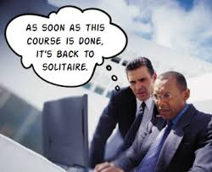
Objectives
Purpose of a resume
What recruiters want to see from a resume
Create an updated resume for current workforce
Types of resumes
Notes:
Speaker’s Notes
Review the objetives of the class.

Slide 4

Yes, Resumes are Still Required
With employers receiving hundreds of resumes, it is so important to stand out in the crowd.
How many seconds do you have to hook an employer’s or a recruiter’s attention?
Notes:
Speaker’s Notes
Regardless of what you may hear. Resumes are still critical for today’s job search and you will want one that stands out from the others. Your resume should look professional and speak to the position you are applying to.
Suggestions for the Speaker
Ask the audience--Who has a resume they are proud of? Chances are it is still work in progress.
It is our Marketing piece. Help audience understand this. Because we are no better than Coke (or Pepsi) at this point. Ask how in the sea of soft drinks how will one stand out?
Your resume is has to communicate IMMEDIATELY what your value is to an organization. Yes to bullet points—no lengthy discussions—nothing unrelated to THEIR needs.
So how long does an employer spend looking at your resume? Have audience guess. See next slide for most current time.
4

Slide 5
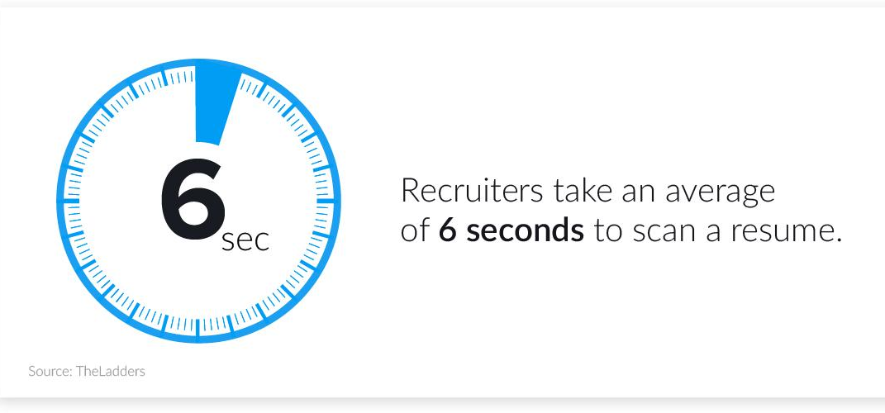
How Long to Screen a Resume?
Notes:
Speaker’s Notes
Ask attendees to think about how quick 6 seconds is? You want the reader to want to continue to look at your resume because you have immediately hooked them.
Suggestions for the Speaker
Feel free to have your own example so others can see how to capture the reader’s attention.
This also helps them to understand why they want to focus on those activities that matter.
5

Slide 6

5 Top Resume Myths
No more than 1 page
Must be chronological
Always list work history first
One resume works for
multiple jobs
Cover letters are obsolete
Notes:
Speaker’s Notes
Ask attendees to think about these myths. Then ask the group what myths they have heard.
Talk about the number of pages of a resume. How long should a resume be? The answer is that the length of your resume depends on a number of factors.
It depends on how much experience you have and what level candidate you are. If you're an entry-level candidate, one page should be plenty. For more experienced candidates it's fine to have a longer resume at two pages. Three pages should be rare.
Resume vs. CV--Unlike a resume, a curriculum vitae (CV) can be very long regardless of the level of the position you are applying for. CVs are typically two or three pages, minimum.
This is because CVs include more information than a resume, including teaching experience, research, awards, publications, presentations, and even affiliations. CVs are commonly used in academia, as well as in the sciences. Make sure you know whether the jobs you are applying for require a CV or a resume.
Suggestions for the Speaker
Acknowledge that there will always be opinions on what you should do and sticking with the basics still works in today’s job market.
6

Slide 7

What Recruiters want to see from job seekers
Resumes Tailored to the Open Position - 63%
Skill Sets Listed First on a Resume - 41%
Cover Letters - 40%
Application Addressed to the Hiring Manager - 22%
Links to Personal Blogs, Portfolios, or Websites - 16%
(Careerbuilder 2017)
Notes:
Speaker’s Notes
Ask attendees if this surprises them? Have they just been using a general resume for all jobs they apply for?
Also, ask about their social media exposure and are they now convinced that it matters after last week.
Suggestions for the Speaker
Cover bullets.
Critical to let them know that in the job search, they have to make it easy for the reader to connect the dots between their resume to the job posting.
Feel free to have your own example of a total mismatch where the job seeker didn’t even bother to show the connection.
Better to have less and make connections, than to have so much info on your resume it is not relevant.
7

Slide 8


What Will Get a Resume Rejected
Rejected
Impersonal Applications (No Hiring Manager’s Name) - 84%
No Thank You Note After Interview - 57%
Resumes Aren’t Customized and Tailored - 54%
No Cover Letter - 45%
No Follow Up With Employer After Interview - 37% (Careerbuilder2017)
Notes:
Speaker’s Notes
Ask attendees to think about times they never heard back after submitting their resume? Did any of these apply for them as they reflect on this? If you have a name to send resume to, be sure to use it. Everything matters in the resume process. Job seekers should always follow the directions given in the job posting.
Suggestions for the Speaker
Feel free to have your own example so others feel comfortable sharing with the class. You can find so many examples online. One of the worst is to apply with LinkedIn and your LinkedIn profile is woefully incomplete.
All of these matter and will demonstrate your professionalism. A thank you not will set you apart as a job seeker. So few are sent out. A handwritten thank you note will be remembered.
8

Slide 9
Key Words Help to Stand Out
Restate position title
Include attributes of job description
  Ad: Need self-directed IT programmer with 7 years experience for server refresh project.
  YOU: IT programmer with over 10 years experience in server installation and maintenance…My thorough understanding of servers has enabled me to complete system installations ahead of schedule…
Be succinct, be specific, & be brief
Notes:
Speaker’s Notes
Key Words will get a recruiter’s in your resume. Again, helping the reader connect the dots and showing them you have the skills they are looking for. Less is more if you have the right key words and you took the time to customize your resume.
Suggestions for the Speaker
9

Slide 10

Word Clouds and Key Words
Word clouds give greater prominence to words that appear more frequently in the source text.
Check out
Worditout.com
Notes:
Speaker’s Notes
Because Key Words are important in your resume, you should become familiar with word clouds. This will help you quickly determine which words are showing up the most in the job posting and therefore, important for the job. You want these to show up on your resume.
https://worditout.com/word-cloud/create
Suggestions for the Speaker
Demonstrate Wordle.net or any other word cloud in real time if you have internet access. Copy and past a job description into Wordle. This will show the group how easy it is to use and also how useful it can be for them.
Feel free to have your own examples to distribute for the class to review.
Emphasize this will help set them apart from the sea of resumes, because most job seekers don’t do this.
10

Slide 11
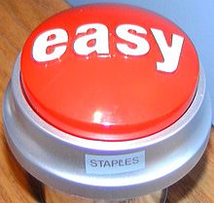
Make Your Resume Easy
We read from left to right
Use left alignment
Omit columns White space is OK
Use simple fonts: Arial, Helvetica, Times Roman
Limit underlining, italicizing, borders
First time use, be sure to spell out acronyms and abbreviations to ensure meaning ---Associates in Arts (AA), Applied Aerodynamics (AA), Anesthesiologist's Assistant (AA)

Slide 12

Preparing to Write Your WOW Resume
Focus and Action
Gather your past resumes, recommendations, evaluations and reviews, and new job postings or career opportunities
Make a list of your skills
Identify your strengths/likes
  Strength Finder 2.0
  Career Choice/Change
Notes:
Speaker’s Notes
This will require one’s focus and attention to gather everything. This is the time a job seeker wants to collect all of their work materials. Not only will it help them build their “Master Resume (on next slide) –it will also reinforce how much they have already accomplished and give them confidence and motivation.
Suggestions for the Speaker
1. Create a list with the group for transferable skill sets. Document all of your transferable skill sets e.g. customer service experience, project management, communication, analytics, and research are just a few.
12

Slide 13

First, Create a Master Resume
  Professional Summary
  Accomplishments
  Qualifications
  Employment History
  Education
  Special Training
  Volunteer
Notes:
Speaker’s Notes
A master resume is a document that functions as a source to help you create other resumes. It is not meant to serve as the template—and is never to be submitted. Instead, it allows you to list every skill you've acquired, your valid education, all of your jobs, etc. in one place. It will be your document that you can use to create your customized resumes.
Once you have written your master resume, proof and spell check it carefully so it is ready to go. Now you have a complete, accurate and honest list of all of your accomplishments. The real power behind your master resume is the ability to quickly cut and paste selected work histories to create custom resumes and cover letters for your job search.
Suggestions for the Speaker
Share an example of a master resume.
Point out these benefits for investing in a Master Resume:
It streamlines making custom versions
It simplifies remembering past jobs
It helps you spot themes and patterns
It helps you highlight your favorite tasks
It helps you overcome the problem of the generic resume
It allows you to describe different skill sets
13

Slide 14


Types of Resumes
List A
Chronological
Functional
Combination/Hybrid
List B
Scannable
PDF
Email
Which one do choose?
Notes:
Speaker’s Notes
Distribute a Chronological and a Functional example so group can see the difference.
What are they asking for?
Chronological: considered antiquated by some in the resume world. It lists your jobs from most recent to last. A resume should never go more than 10-15 yrs. Use this format if the employer specifically asks for it.
Functional: Focuses on your skill sets rather than where you worked. Good for those who have job hopped a lot—or have worked in multiple industries, or work in the communications/ artistic field. It demonstrates your skill sets, trainings rather than your job history and can help with employment gaps.
Combination or Hybrid: A targeted hybrid resume can be useful if you have job hopped or maybe don’t have all education requirements. You will want to showcase your jobs and responsibilities le to help connect the dots for the reader. Try not to get caught up in what type of resume you should have. If you follow a few simple rules you can create a living breathing document that can be tailored easily to every job you apply for. A combination or hybrid resume communicates easily and effectively how you are a great candidate for the position IMMEDIATELY.
Hybrid Simple Way:
Job description: Highlight everything. Use what they are looking for in 5-8 bullet points in top 1/3 of the resume.
In that top half of your resume—you are going to tell them everything they need to know to call you in for an interview.
It doesn’t have to be 100%--if you have 75% of what they are looking for—go ahead and apply anyway.
SCANNABLE: If you are applying to a larger company—most likely they will be using an ATS or Applicant Tracking System. It is a scanning software that looks through resumes for key words. In that case: Stay away from fancy fonts: Stick to Arial, Times New Roman or Helvetica which are easy to read—Don’t use abbreviations or foreign names (for example graduated “cum laude” should be graduated with honors”
Stay away from pre-formatted resume builders. It will choke an ATS.
Make sure your resume is in a clear concise format with your contact information located at the top instead of a header or footer.
Convert your resume to a PDF. Your formatting will not be compromised when recruiters view it through Google docs or other previewable software. PDF: Especially if you are using a non-traditional font, you should convert to a PDF.
Email in the body of the resume—automatically do it or not? If you can attached a PDF that is preferred.
14

Slide 15
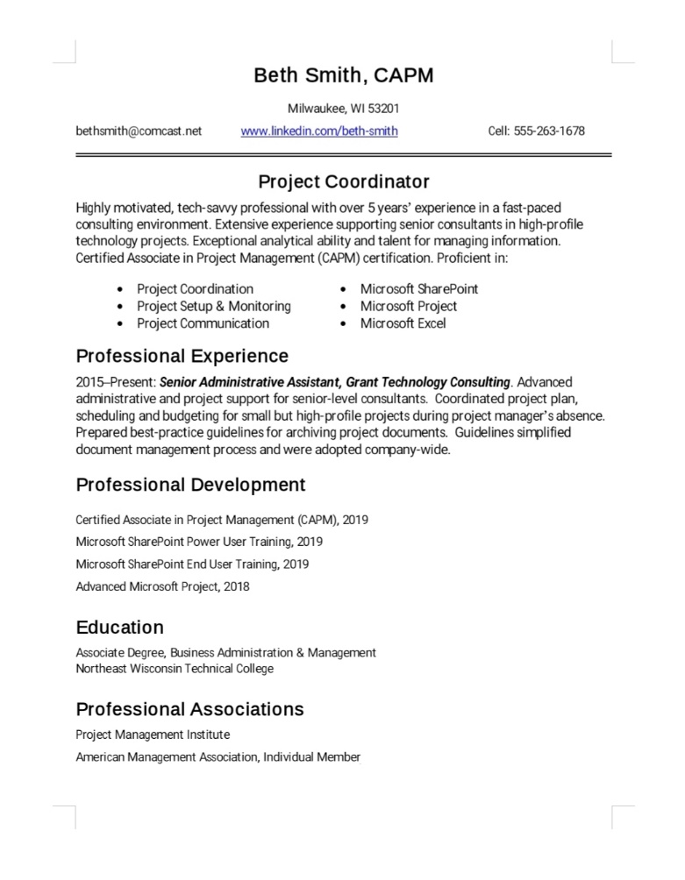
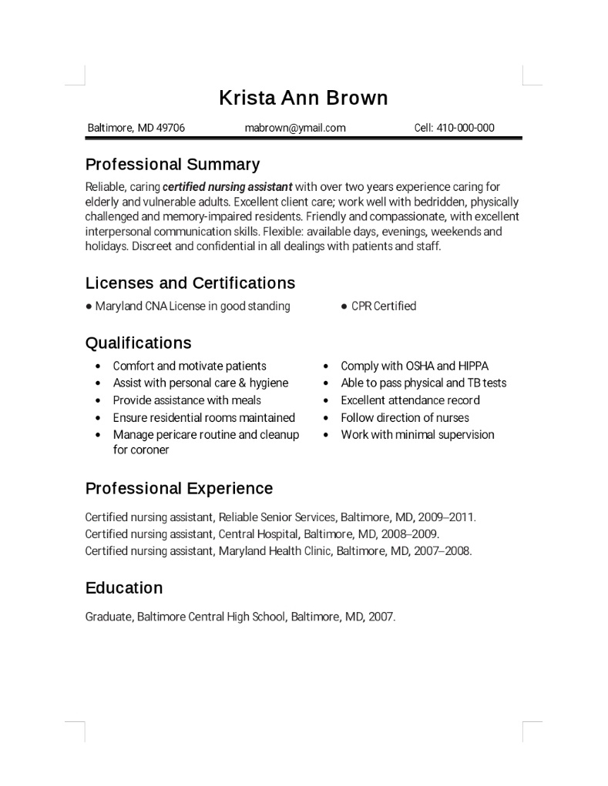
Resume Samples
Chronological
Functional

Slide 16

Know your Market Value
A resume addresses a person’s market value. In 45 seconds or less, it needs to answer the question:
Why should we hire you?
Notes:
Speaker’s Notes
A resume is used as a screening device to help select applicants for the interview.
Typical time spent to determine if a person is qualified to for the position on a resume is 45 seconds—however, it only takes an employer 5-10 seconds to assess if we should read on.
You have got to answer the question “Why should we HIRE YOU”
You can ask any hiring manager or HR person and they will tell you, they do want you to be the right person for the job. If you show them that you have the skills they are looking for—and MAKE IT EASY FOR THEM—Your chances for an interview increase dramatically
Suggestions for the Speaker
Ask the question:
How will you demonstrate your market value? Look for answers that will connect the dots for reader and also for answers that quantify your past successes.
16

Slide 17

Understand Your Audience
Applicant Tracking Systems or ATS
H.R. or Admin Staff
Recruiters: Corporate vs. Agency
Hiring Managers
Notes:
Speaker’s Notes
When somebody advertises a position—you are competing with 100’s of other applicants: They may or may not be qualified.
Applicant Tracking System—Scannable Resume
If we apply directly to the company—and they may us to input our information into their website—like asking you to create a user name and password: they are using an ATS or Applicant Tracking System. If enough key words satisfy their query, it will go into a prescreened applicant pool for the company HR or Recruiters to follow up on. It is very important to create a resume that is a text document. Use note pad, write pad, or copy/paste your resume into the body of an email and send it to yourself so that you can see how the text comes out!
H.R. or Admin Staff: Culls through the 100’s resumes and sorts what they think are good candidates. They may or may not do a phone prescreen—but they will pass on your resume to a recruiter who will most likely do the first face to face interview. There is a system for sorting and it’s very simple “YES/NO/MAYBE Pile”
Internal or Corporate Recruiters:
They must answer to multiple departments with multiple openings, as well as to internal candidates transferring to other departments. If you get the name of a recruiter—that is great—but where you really want a contact is with the direct supervisor or hiring manager.
They are looking to fill their openings as quickly as possible.
Companies will stop looking once they get a decent pool of candidates. Get in early BEFORE they advertise!
Agency Recruiters: Very different than Corporate Recruiters: They are your Randstads, Manpower, Robert Half:
They might be a good bet for you—and might not. There are different types: Temp Staffing/ Permanent Hires/Head
4: Hiring Managers: May take the time to actually read your resume—if they have the time—but most don’t! They are most likely to look at referrals—because they are the ones who need to make the ultimate hiring decision. So why is a referral important? Because we trust our current employees and will take their referral seriously.
Suggestions for the Speaker
17

Slide 18

Target your Companies
Who do YOU want to work for?
Create a list of companies where you WANT to work
Research companies
  Learn about the industry
  Find an advocate
  Set up an informational interview
Resources include:
  Company Website – LinkedIn – Facebook – Google company –Local Business Journal
  Hoovers, Glassdoor, Industry Association
Notes:
Speaker’s Notes
There is tremendous power when we focus on a list vs. trying to apply anywhere and for everything. Cover these points and help group understand there are many avenues to research and learn about companies.
Suggestions for the Speaker

Slide 19
Create a Targeted Resume
Print out every job description
Target your resume to demonstrate that you have what employer is looking for – every time!
Quantify your results
Notes:
Speaker’s Notes
For success do a targeted resume EACH & EVERY TIME!
Research the position/company. Use their lingo in describing your experience. Know why you want to work there.
Take the job description: Highlight all the things you have done and include them in your professional summary or in your selected highlights section.
Bullet point all of your achievements that happened while on the job. Did you make the company money? Save the company money? Save them time by streamlining their processes?
Suggestions for the Speaker
Points to make:
1. Relay your transferable skill sets--If you have a hard time building on your successes, think of what you were hired to do—and how your responsibilities increased –it can help showcase your success at the job
2. Revise: to suit that particular job--Don’t forget to print out the job description—as once employers get a pool of qualified applicants they will pull the job posting—and you may forget what job you actually applied to. You should always keep a current journal of positions you have applied to
19

Slide 20
Laser Focused Resume
Top Half Matters
Executive/Professional Summary
2-3 Lines outlining your value to an organization
Start with years of experience - more than 2 years, less than 15
Highlights of Qualifications
5-8 Bullet points of relevant experience
Quantifiable results of relevant or valuable contributions
Awards or Certifications
Relevant education or training
Notes:
Speaker’s Notes
Top half of resume is your prime real estate. It compels readers to keep reading. Make your words count and connect to the job posting.
Suggestions for the Speaker
Activity- Advise the participants to bring 2 copies of their resume. When you get to this slide emphasizing the top third of the resume should clearly explain who you are and what you’re looking for. Have particpants trade with a partner and have the partner summarize what the other partner is looking for.

Slide 21

What to Leave off Today’s Resume
Objective
1st or 3rd person
Salary history
Reason for leaving
Photographs
References Available Upon Request
Notes:
Speaker’s Notes
Use professional summary or summary instead of objective. This is not about you, it is about the value you will bring to the company. References can be provided later if asked for an interview. No photos. Lead with verb e.g. Created, Developed, Increased for bullet points.
Suggestions for the Speaker

Slide 22
Use Success Verbs
Achieved Eliminated Exceeded
Added Expanded Gained
Awarded Improved Generated
Changed Increased Grew
Contributed Introduced Optimized
Decreased Maximized Reduced
Delivered Minimized Saved
Notes:
Speaker’s Notes
Every bullet point in your resume should include a success verb. Static verbs such as “managed” don’t show what you were able to accomplish on the job.

Slide 23
Use success Phrases
Increased customer visits by 17%without increasing ad budget
Introduced 2 new products that led to 2,500,000 increase in MAUS
Reduced cost per hire by $7010 though employee referral program
Successfully added 3 productive warehouses to our nationwide network
Notes:
Speaker’s Notes
The

Slide 24

A Bit About Cover Letters
Who reads them?
Shows interest in employer
Chance to stand out
Communicates career goals
Can use it to overcome barriers, address challenges, issues or gaps in employment
Notes:
Speaker’s Notes
Distribute Sample Cover Template
Applicants often ask if they need to include a cover letter when it is not explicitly required by an employer. The short answer is yes, you should always submit a cover letter, even if it is not required. Recruiters may not always read them but hiring managers do.
Do not include if employer says not to submit one. Also if you're applying online for a job and there is no way to upload or post a cover letter, don't worry about it.
Suggestions for the Speaker
Stress to job seekers that a cover letter doesn’t have to be long. A cover letter adds focus to a resume. Few employers seriously consider a resume that is not accompanied by a cover letter; so a cover letter needs to be part of your job-search strategy. A cover letter tells the employer the type of position you're seeking — and exactly how you are qualified for that position.

Slide 25
What a Cover Letter Should Include
Introduction paragraph should address position, title and personal brand as well as enthusiasm for the position
Body should tie experience to job description or address any issues
Conclusion should be demonstrate interest in employer and reaffirm value
Notes:
Speaker’s Notes
Cover points on slide and handout from previous slide.
Suggestions for the Speaker

Slide 26
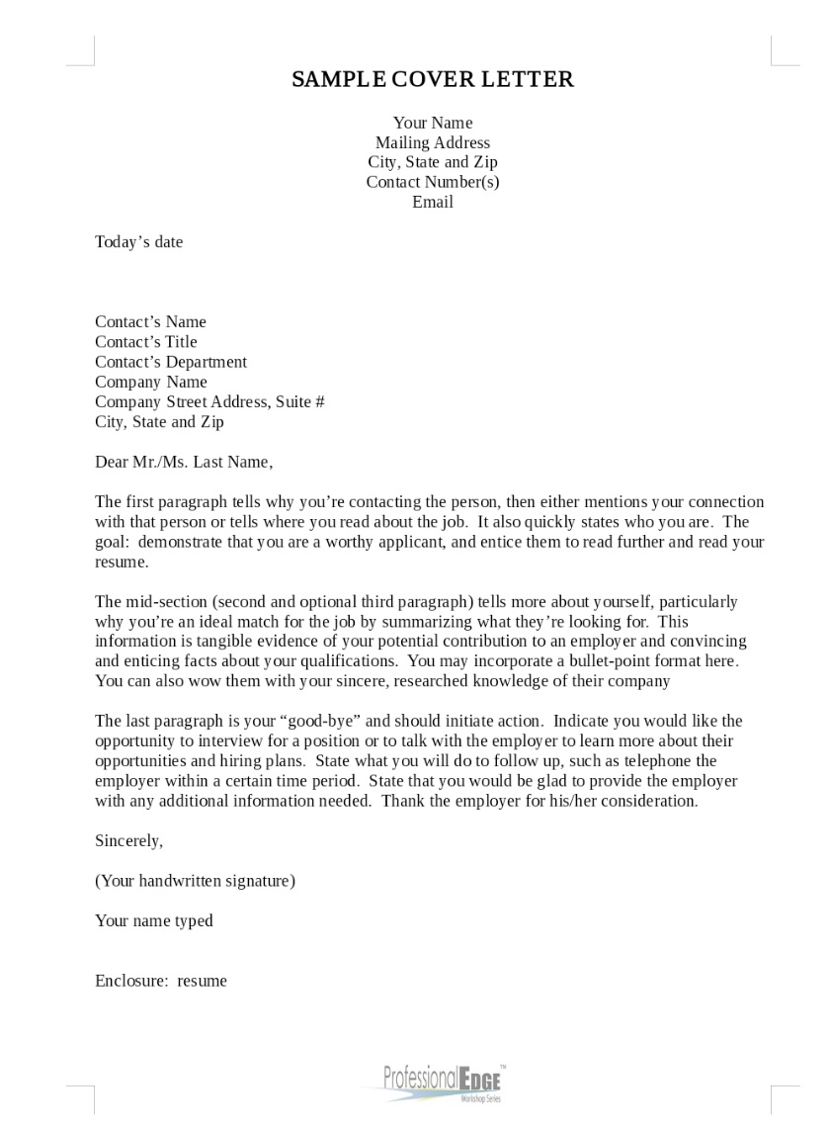
Cover Letter Sample

Slide 27
Branding-It is all in the Name
    SARAH B. ALLEN
    Sacramento, CA 95815
    (916) 921-1312 allen2012@gmail.com
    www.linkedin.com/in/sarahallen
    Try to have an email address that ties to your entire name and is easy to remember. The email above is ok. This one would be better:
    sarahallen@gmail.com
Notes:
Speaker’s Notes
Have the same email for your job search and contact information. Always include your contact information on any correspondence, even an email. Make it easy for the employer or recruiter to reach you.
Suggestions for the Speaker

Slide 28
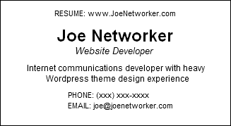
Business Cards for Networking
Notes:
Speaker’s Notes
In the business world, you’re not a “bona fide” player unless you have a card. It’s especially important if you’re unemployed and actively going to networking events, job fairs, and interviews. Handing out your resume can be awkward at networking events. Your business card is your calling card. There’s nothing worse than meeting someone at a professional event and you have nothing to hand back but a ripped-up piece of paper or your old company card with your new contact information penciled in. Not exactly a great first impression.
Sample above—can also include city and state and LinkedIn URL. Include your title even if you are not working for a company at the time. You are still that person and have the skills and experience.
Suggestions for the Speaker
Be consistent with contact information.

Slide 29

Where do Job Seekers go to look for Jobs?
Company Websites - 77%
Referrals - 71%
Suggestions from Friends or Family - 68%
Online Job Sites (Monster, CareerBuilder) - 58%
Publications or Online Sources in a Field - 57%
General Web Search (Google, Bing, Yahoo) - 55% (Gallup State of the American Workplace Report 2017)
Notes:
Speaker’s Notes
Self explanatory slide, important to note—get your family and past work colleagues involved for you too. Share your resume with them. They can help your search.
Suggestions for the Speaker
29

Slide 30

Network your Resume
Be in control of your job search
Network… Network… Network!
MARKETING
YOU!!
Notes:
Speaker’s Notes
A resume is a snapshot of your professional life. It is not your whole life story summed up in a couple of pages. It’s the highlighted version of your professional value. You will want to make sure it is shared with those who can help you.
A resume is your marketing piece.
It is a brief description of a person’s education, work experience, special skills and interests.
It is meant to introduce you to a potential hiring manager or employer. It is meant to entice, and draw people in
A resume will not get you a job alone.
It’s purpose is to get you an INTERVIEW
Think about it….You don’t want to get married—you just want a DATE!!! Leave the extra history (or baggage) behind. Communicate “Here is What I can do for YOU!”
Suggestions for the Speaker
Have group list where and how they can network their resume? They should make their own personal list.
30

Slide 31

Ageism
Too much experience/made too much money
Not enough experience in industry
Job hopping
Gaps in employment
Education
Common Barriers
Notes:
Speaker’s Notes
What job seekers have told us
Ageism: Work Ethic of a “mature” worker? Mature worker brings lots of life and work experience
Too much experience: Work vs. Quality of life. $$$: Money not an issue. Times have changed—hey day behind us—now happy to mentor others in the business—intrinsic value vs. monetary. SLIM DOWN your resume
Not enough experience: RESEARCH INDUSTRY—Informational interviews—get versed on industry lingo, companies in biz and competition. What is the future of this industry?
Job Hopping: Functional vs. Chronological resume: Highlight skills and experience over dates worked
Gaps in Employment: Fill them with volunteer activities, educational pursuits, or with a good explanation
Education: Not enough: Sign up for an online college class—list recent trainings/certifications
Too Much? Slim it down and make it relevant.
Suggestions for the Speaker
Help job seeker optimize what they have especially when it is relevant. This can be tough for some to discuss.

Slide 32

Keys to Success
Resumes must focus on your value to employers
Every resume must be quantified, targeted & customized
A resume is your marketing tool and should ideally, always follow you!
Notes:
Speaker’s Notes
Any questions on anything we have covered?
Suggestions for the Speaker
They will want to work on their resumes before the interview workshops.

Slide 33
Thank you!!
Questions?

